Slide 1

P peline
The Data
Machine Learning I: Probability and Classification.
© Jennifer Mankoff
The Data Pipeline; HCII; Spring 2014
Slides modified & borrowed from Carolyn Rosé
Want to go deeper? http://see.stanford.edu/see/lecturelist.aspx?coll=348ca38a-3a6d-4052-937d-cb017338d7b1

Slide 2
First…
Some demos from your Byte 4 ☺

Slide 3

Naïve Approach: When all you have is a hammer…
Data
Target
Representation

Slide 4
Naïve Approach: When all you have is a hammer…
Data
Target
Representation
Problem: there isn’t one universally best approach!!!!!

Slide 5

Slightly less naïve approach: Aimless wandering…
Data
Target
Representation

Slide 6
Slightly less naïve approach: Aimless wandering…
Data
Target
Representation
Problem 1: It takes too long!!!

Slide 7
Slightly less naïve approach: Aimless wandering…
Data
Target
Representation
Problem 2: You might not realize all of the options that are available to you!

Slide 8

Expert Approach: Hypothesis driven
Data
Target
Representation
KEY!!: Hypotheses are generated from insight into the language.
Error analysis will be a key technique!!!

Slide 9
Expert Approach: Hypothesis driven
Data
Target
Representation
You might end up with the same solution in the end,
but you’ll get there faster.

Slide 10
Expert Approach: Hypothesis driven
Data
Target
Representation
Today we’ll start to learn how!

Slide 11

Suggested Readings
Witten, I. H., Frank, E., Hall, M. (2011). Data Mining: Practical Machine Learning Tools and Techniques, third edition, Elsevier: San Francisco
Suggested watching (or see his coursera course) http://see.stanford.edu/see/lecturelist.aspx?coll=348ca38a-3a6d-4052-937d-cb017338d7b1

Slide 12
“Just enough to be dangerous”…
ML department devoted to this subject!
Practical start
(Very) basic concepts
A start on what questions to ask
But don’t leave thinking you now know all about ML!

Slide 13
What is machine learning?
Automatically or semi-automatically
Inducing concepts (i.e., rules) from data
Finding patterns in data
Explaining data
Making predictions

Slide 14
What is machine learning?
Two steps
Training
Data
Learning Algorithm
Model

Slide 15
What is machine learning?
Two steps
Training
Prediction
Data
Learning Algorithm
Model
Classification Engine
Prediction
New Data

Slide 16
Example uses of ML
Recognizing what appliance is being used from whole-house energy (“NILM”)
Recognizing activities
Predicting grid loads
Predicting sewer overflows
…

Slide 17
Example 1: Grid Load
GIVEN “features” such as
Outside temp
Time of day
…

Slide 18
Example 1: Grid Load
GIVEN “features” such as
Outside temp
Time of day
…
PREDICT expected load (continuous)

Slide 19
Example 1: Grid Load
GIVEN “features” such as
Outside temp
Time of day
…
PREDICT expected load (continuous)
Typical approach: “Linear Regression”
Load
Temp
Time

Slide 20
Regression: Machine Learning Perspective
Take a set of observed features F = <f1, f2, f3,…> (a feature vector)
Use this to estimate a resulting value
(a prediction)

Slide 21
Features
Features may be in several forms, for example
Numbers (in a range or unbounded)
Discrete values from a small set
Discrete values from a large set (e.g., strings)

Slide 22
Features
Features may be in several forms, for example
Numbers (in a range or unbounded)
Discrete values from a small set
Discrete values from a large set (e.g., strings)
Can refine/combine
Discretize (“bucket”)
Threshold
Calculate over windows of time: Average/min/max in the last 15 seconds

Slide 23
Example: Sewer Overflows
GIVEN “features” such as
Steeler’s Game Ad?
Weather
…

Slide 24
Example: Sewer Overflows
GIVEN “features” such as
Steeler’s Game Ad?
Weather
…
PREDICT overflow (yes or no)

Slide 25
Example: Sewer Overflows
GIVEN “features” such as
Steeler’s Game Ad?
Weather
…
PREDICT overflow (yes or no)
Class “A”

Slide 26
Example: Sewer Overflows
GIVEN “features” such as
Steeler’s Game Ad?
Weather
…
PREDICT overflow (yes or no)
Class “B”

Slide 27
Example: Sewer Overflows
GIVEN “features” such as
Steeler’s Game Ad?
Weather
…
PREDICT overflow (yes or no)
Typical approach: “Classification”

Slide 28
Classification
Take a set of observed features F = <f1, f2, f3,…> (a feature vector)
Use this to estimate which class it belongs to
(a prediction)

Slide 29
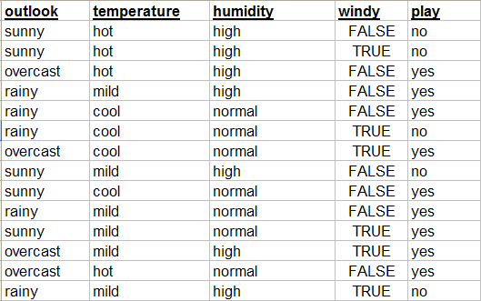
How does classification work?

Slide 30
Learned Classifiers
For training, need both observed features and the corresponding true class (label)
Need multiple examples (instances)
Some techniques function without labels [not covered today though]

Slide 31
How does classification work?
Features

Slide 32
How does classification work?
Class

Slide 33
How does classification work?
Two simple algorithms
0R – Predict the majority class
1R – Use the most predictive single feature

Slide 34
How does classification work?
A slightly more sophisticated rule learner
will find the feature that gives the most
information about the result class. What
do you think that would be in this case?
The simplest rule learner will
learn to predict whatever is
the most frequent result class.
This is called the majority
Class.
Outlook:
Sunny -> No
Overcast -> Yes
Rainy-> Yes
<Feature Name>:
<value> -> <prediction>
<value> -> <prediction>
…
What will the rule be in this case?
It will always predict yes.

Slide 35
What will the prediction be?
Model
Outlook:
Sunny -> No
Overcast -> Yes
Rainy-> Yes
New Data
Yes

Slide 36
0R & 1R Classification
Problem: Brittle and error prone
Instead, ML classifiers use statistical models to learn from past data
Notes:
Very powerful…

Slide 37
Learned Classifiers
Training Time
Method to get Ground Truth
Training Data Set
Feature Gen
f₁ | f₂ | f₃ | … | Label
A | 42 | 17 | … | Yes
C | 78 | 25 |  | No
X | 32 | 4 |  | Yes
Learner
Sensors
Classifier

Slide 38
Learned Classifiers
Run/Classify Time
Feature Gen
Sensors
Classifier
Class

Slide 39
Learned Classifiers
Training Time
Training Data Set
Feature Gen
f₁ | f₂ | f₃ | … | Label
A | 42 | 17 | … | Yes
C | 78 | 25 |  | No
X | 32 | 4 |  | Yes
Learner
Sensors
Many learning algorithms to choose from
A few of the simplest ones tend to perform well
Naïve Bayes
Decision Trees
Regression-based Models (for continuous)
Classifier

Slide 40
Learned Classifiers
Training Time
Training Data Set
Feature Gen
f₁ | f₂ | f₃ | … | Label
A | 42 | 17 | … | Yes
C | 78 | 25 |  | No
X | 32 | 4 |  | Yes
Learner
Sensors
Many learning algorithms to choose from
A few of the simplest ones tend to perform well
Naïve Bayes
Decision Trees
Regression-based Models (for continuous)
Classifier

Slide 41
Learned Classifiers
Training Time
Training Data Set
Feature Gen
f₁ | f₂ | f₃ | … | Label
A | 42 | 17 | … | Yes
C | 78 | 25 |  | No
X | 32 | 4 |  | Yes
Learner
Sensors
Many possible features
Different sensors
Multitude of ways to generate features
Many ways to transform and combine features
Some much more predictive / useful than others
→ “Feature selection” tends to be very important
Classifier

Slide 42
Learned Classifiers
Training Time
Training Data Set
Feature Gen
f₁ | f₂ | f₃ | … | Label
A | 42 | 17 | … | Yes
C | 78 | 25 |  | No
X | 32 | 4 |  | Yes
Learner
Sensors
Labeled data tends to be hard to come by
Tend to be expensive to gather or just non-existent
Typically need a lot of data to do well
Prefer 1000s of training samples
→ For HCI problems, finding ways to get good labels tends to also be a key
Classifier

Slide 43
Classification (Learning) Algorithms
Two of the simplest alg. tend to give very good results on discrete (non-sequence) classification
Efficient training and classification time
Comparatively simple and easy to use (not a lot of parameters to set, etc.)
Generally seem to work about as well as, sometimes better than “more sophisticated” things for HCI classification problems I have encountered (which typically don’t have special properties)
Naïve Bayes
Decision Trees

Slide 44
We are About to go Through the Math That Shows How These work
Depending on your stats background you may find this hard to follow, but…
It’s actually not that complex if you go through it step by step
You won’t need to use these formulas directly (someone will typically have put them in code you can just use) so you can probably live without understanding each and every part, but…
You do need to see enough of the details to know this is not “magic”, and so…

Slide 45
Probability and Probability Notation
Have some set of things we are interested in
A particular universe of things
Let’s say: “Scott’s current activity (during a weekday)” which can be: {Lecturing, Mtg, Eating, Sleeping, Other}
P(A) - “probability of A”
- the probability that if we sample randomly from our universe we will see A

Slide 46
Probability and Probability Notation
P(A) - “probability of A”
- the probability that if we sample randomly from our universe we will see A
P(A) = |A|
|U|
U
A

Slide 47
Probability and Probability Notation
P(A) - “probability of A”
- the probability that if we sample randomly from our universe we will see A
P(A) = |A|
|U|
U
A

Slide 48
Probability and Probability Notation
P(A) - “probability of A”
- the probability that if we sample randomly from our universe we will see A
P(A) = |A|
|U|
U
A
Note: at the smallest A is empty (|A| = 0)
at the largest A is all of U (|A| = |U|)
so: 0 ≤ P(A) ≤ 1

Slide 49
Probability and Probability Notation
P(A) - “probability of A”
- the probability that if we sample randomly from our universe we will see A
P(A) = |A|
|U|
U
A
Note: We are often dealing with finite sets of things (or we are assuming that things we are interested in are well approximated by a finite set)
So we can often just count to get e.g., |A| vs. |U|

Slide 50
Probability and Probability Notation
Examples:
P(sleeping) = 8*5 = 0.25
24*5
P(lecture) = 3 = 0.025
120
P(meeting) = 15 = 0.125
120

Slide 51
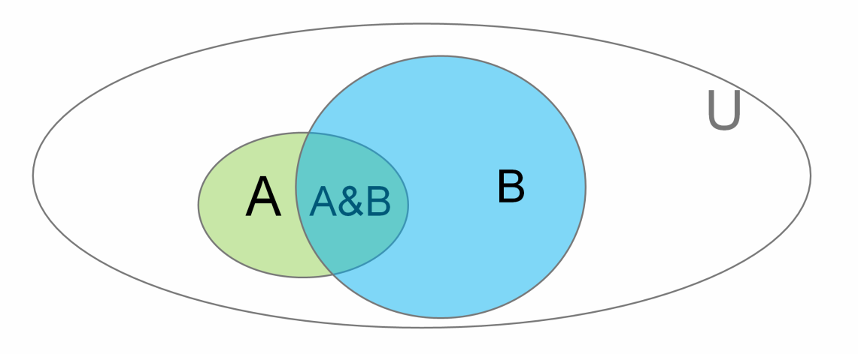
Conditional Probability
We write P(A | B) to denote
“Probability of A given B” (or “… assuming B”)
or
“If we know B is true, what’s the probability of A”

Slide 52
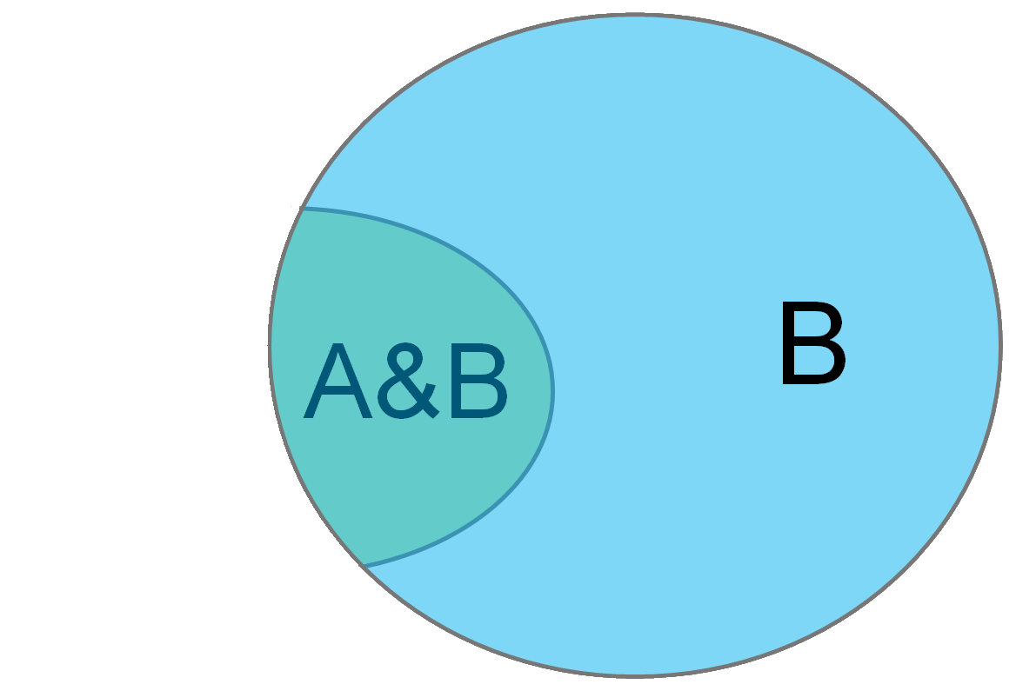
Conditional Probability
P(A | B) - “Probability of A given B”
You can think of this as just a change of universe
Probability of A treating B as the universe
→

Slide 53
Conditional Probability
P(A | B) - “Probability of A given B”
= |A&B|
|B|

Slide 54
Conditional Probability
P(A | B) - “Probability of A given B”
= |A&B|
|B|
Divide top and bottom by |U| …
|A&B|
= |U| = P(A&B)
|B| P(B)
|U|

Slide 55
Conditional Probability Example
Consider Jen’s Mobile data:
Location: {Shadyside, NSH, Hidden Valley, Other}
Activity: {Biking, Vehicle, Walking, Still, Other}
Conditional probabilities are useful in classification:
P(Walking| Location=Shadyside)
P(Sleeping | Activity=Still), etc
We can estimate these based on body of prior observations (e.g., count how many times walking when location was Shadyside)

Slide 56
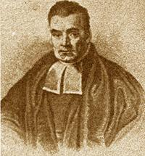
Naïve Bayes
Based on Bayes law
http://en.wikipedia.org/wiki/Bayes'_theorem
http://yudkowsky.net/rational/bayes
http://oscarbonilla.com/2009/05/visualizing-bayes-theorem/
Bayes Law (AKA Bayes theorem):
Rev. Thomas Bayes 1702-1761
P(B | A) P(A)
P(A | B) =
P(B)

Slide 57
Why is that true?

Slide 58
Why is that true?
P(A | B) = P(A&B)
P(B)

Slide 59
Why is that true?
P(A | B) = P(A&B)
P(B) → P(A | B)P(B)= P(A&B)

Slide 60
Why is that true?
P(A | B) = P(A&B)
P(B) → P(A | B)P(B)= P(A&B)
Now the converse
P(B | A) = P(A&B)
P(A) → P(B | A)P(A)= P(A&B)

Slide 61
Why is that true?
P(A | B) = P(A&B)
P(B) → P(A | B)P(B)= P(A&B)
Now the converse
P(B | A) = P(A&B)
P(A) → P(B | A)P(A)= P(A&B)
P(A | B)P(B) = P(B | A)P(A)

Slide 62
Why is that true?
P(A | B) = P(A&B)
P(B) → P(A | B)P(B)= P(A&B)
Now the converse
P(B | A) = P(A&B)
P(A) → P(B | A)P(A)= P(A&B)
P(A | B)P(B) = P(B | A)P(A) divide by P(B)

Slide 63
Why is that true?
P(A | B) = P(A&B)
P(B) → P(A | B)P(B)= P(A&B)
Now the converse
P(B | A) = P(A&B)
P(A) → P(B | A)P(A)= P(A&B)
P(A | B)P(B) = P(B | A)P(A) divide by P(B)
P(B | A) P(A)
P(A | B) =
P(B)

Slide 64
Bayes Law
Bayes Law (AKA Bayes theorem):
Rev. Thomas Bayes 1702-1761
P(B | A) P(A)
P(A | B) =
P(B)

Slide 65
Naïve Bayes
Would like to know the probability that the true class is C_{i} given the occurrence of observed feature vector F = <f₁, f₂, …, f_{n} >
Compute as:
P(F | C_{i}) P(C_{i})
P(C_{i} | F) =
P(F)

Slide 66
Naïve Bayes
Would like to know the probability that the true class is C_{i} given the occurrence of observed feature vector F = <f₁, f₂, …, f_{n} >
Compute as:
P(F | C_{i}) P(C_{i})
Likelihood * Prior
P(C_{i} | F) =
=
P(F)
Evidence

Slide 67
Naïve Bayes
Would like to know the probability that the true class is C_{i} given the occurrence of observed feature vector F = <f₁, f₂, …, f_{n} >
Compute as:
Class C_{x} with the highest computed probability is used as the classification result
P(F | C_{i}) P(C_{i})
Likelihood * Prior
P(C_{i} | F) =
=
P(F)
Evidence

Slide 68
Naïve Bayes
Looking at the question:
P(C_{i} | F) > P(C_{j} | F)

Slide 69
Naïve Bayes
Looking at the question:
P(C_{i} | F) > P(C_{j} | F)
P(F | C_{i}) P(C_{i})
P(F | C_{j}) P(C_{j})
>
P(F)
P(F)

Slide 70
Naïve Bayes
Looking at the question:
P(C_{i} | F) > P(C_{j} | F)
Same denominator, so equivalent to:
P(F | C_{i}) P(C_{i}) > P(F | C_{j}) P(C_{j})
P(F | C_{i}) P(C_{i})
P(F | C_{j}) P(C_{j})
>
P(F)
P(F)

Slide 71
Naïve Bayes
Interested in: P(F | C_{i}) P(C_{i}) …
P(C_{i}) is just number of times C_{i} appears in training corpus vs. total number of training instances
If we assume all features in F are independent
– a “naïve” assumption
Then it turns out that P(F | C_{i}) = ∏_{k=1..n} P(f_{k} | C_{i})
where P(f_{k} | C_{i}) is just the count of how many times f_{k} occurs in training instances labeled with C_{i} vs. the total number of training instances labeled C_{i}

Slide 72
Naïve Bayes
The independence assumption
(that puts the naïveté into naïve Bayes)
almost never holds, but the classifiers tend to work pretty well anyway
Will tend to fail when things are highly conditional i.e., System behaves very differently when X is true vs. Y is true
Decision trees (other major simple technique) handle that case really well

Slide 73
Naïve Bayes
More things to note:
Had: P(F | C_{i}) P(C_{i})
What happens when C_{i} never occurs in the training data?
P(C_{i}) = 0, therefore C_{i} never wins & is never selected!
(A common variant puts a minimum on P(C_{i}) to avoid this, but in general rare events can be hard to handle well)
We have implicitly assumed F_{k} comes from a discrete set e.g., so we can simply count the occurrences to compute P(F_{k} | C_{i})
There are good ways to quantize (pick good “bins”) for e.g., numeric features automatically, but we won’t cover this

Slide 74
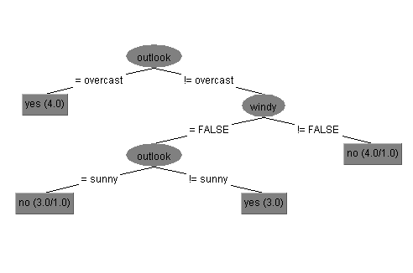
More Complex Algorithm… Decision Trees
Notes:
Only 2 mistakes!

Slide 75
Decision Trees
… One of two major “classic” classification algorithm (with Naïve Bayes)

Slide 76
Decision Trees
Uses simple nested conditional structure
Tree structured
At each interior node we look at one feature
Value of this feature selects a sub-tree for making the rest of the decision (so edges are labeled with feature values)
At leaves we make a classification (assign the class)

Slide 77
Decision Trees
Easy to train a decision tree classifier recursively…
BuildTree(trainingSet)
// base case … (more base cases later)
If trainingSet only has one label on all instances
Return new Leaf(trainingSet.label)
// recursive case
Pick a feature Fn we haven’t split with before // … how?
result = new SplitNode(Fn)
For each value unique value f_{i} of feature Fn
trainSubset= subset of trainingSet with Fn= f_{i}
Result.addChild(BuildTree(trainSubset))
Return result

Slide 78
Decision Trees
How do we pick features to base splits on?
Some features might be mostly noise (not very predictive of label)
splitting with doesn’t narrow down your decision much
Other features might have high information content
Notes:
Intuitively would like the features with the most information in them
Turns out there is a nice information theoretic way to estimate this: “Information Gain”
… will need a short trip into information theory

Slide 79
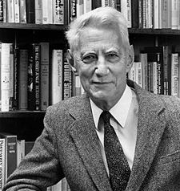
Information Entropy
(AKA Shannon Entropy) is a measure of uncertainty
Less uncertainty (less entropy) → more predictable → less information
Provides a lower bound on the average number of bits needed to encode / transmit something
Intuitively that is proportional to how much information is in the thing to be transmitted
Claude Shannon (1916-2001) The father of information theory

Slide 80
Information Entropy
Assume a discrete random variable X w/ values {x₁,x₂…,x_{n}}
Uncertainty u_{i} associated with x_{i} (the number of bits needed to designate x_{i} in a message) defined as :
If X was uniformly distributed [P(x_{i}) = 1/n]:
u_{i} = log₂ n
For arbitrary non-uniform distribution:
u_{i} = log₂(1/P(x_{i})) = - log₂P(x_{i})
Entropy gives the average number of bits to encode a message of symbols drawn from X
Entropy(X) = H(X) = P(x₁) u₁+ P(x₂) u₂ +…+ P(x_{n}) u_{n}
= - ∑_{i=1..n} P(x_{i}) log₂ P(x_{i})

Slide 81
Information Entropy
Assume a discrete random variable X w/ values {x₁,x₂…,x_{n}}
Uncertainty u_{i} associated with x_{i} (the number of bits needed to designate x_{i} in a message) defined as :
If X was uniformly distributed [P(x_{i}) = 1/n]:
u_{i} = log₂ n
For arbitrary non-uniform distribution:
u_{i} = log₂(1/P(x_{i})) = - log₂P(x_{i})
Entropy gives the average number of bits to encode a message of symbols drawn from X
Entropy(X) = H(X) = P(x₁) u₁+ P(x₂) u₂ +…+ P(x_{n}) u_{n}
= - ∑_{i=1..n} P(x_{i}) log₂ P(x_{i})

Slide 82
Information Entropy
Assume a discrete random variable X w/ values {x₁,x₂…,x_{n}}
Uncertainty u_{i} associated with x_{i} (the number of bits needed to designate x_{i} in a message) defined as :
If X was uniformly distributed [P(x_{i}) = 1/n]:
u_{i} = log₂ n
For arbitrary non-uniform distribution:
u_{i} = log₂(1/P(x_{i})) = - log₂P(x_{i})
Entropy gives the average number of bits to encode a message of symbols drawn from X
Entropy(X) = H(X) = P(x₁) u₁+ P(x₂) u₂ +…+ P(x_{n}) u_{n}
= - ∑_{i=1..n} P(x_{i}) log₂ P(x_{i})

Slide 83
Information Entropy
Assume a discrete random variable X w/ values {x₁,x₂…,x_{n}}
Uncertainty u_{i} associated with x_{i} (the number of bits needed to designate x_{i} in a message) defined as :
If X was uniformly distributed [P(x_{i}) = 1/n]:
u_{i} = log₂ n
For arbitrary non-uniform distribution:
u_{i} = log₂(1/P(x_{i})) = - log₂P(x_{i})
Entropy gives the average number of bits to encode a message of symbols drawn from X
Entropy(X) = H(X) = P(x₁) u₁+ P(x₂) u₂ +…+ P(x_{n}) u_{n}
= - ∑_{i=1..n} P(x_{i}) log₂ P(x_{i})

Slide 84
Conditional Entropy
Specific Conditional Entropy
Entropy(F_{a} | F_{b} = x_{i})
Entropy of feature F_{a} among instances in which feature F_{b} = x_{i}
Conditional Entropy across the full training set
Entropy(Y | X): average specific conditional entropy of Y
Entropy in Y if X is known
Also expected number of bits to transmit Y if both sides already know the value of X
Entropy(Y | X) = ∑_{i=1..n} P(X= x_{i}) Entropy(Y | X = x_{i})

Slide 85
Information Gain (AKA Mutual Information or Kullback-Leibler divergence)
IG(Y | X) = Entropy(Y) – Entropy(Y | X) also given as IG(Y, X) and I(Y;X)
Reduction in entropy of Y (uncertainty about Y) by knowing X
If I need to transmit Y, how many bits on average would it save me if both sides already new X
If I am predicting Y how much information does X provide
Case we are interested in: IG(Label | Feature)
Higher IG for a feature indicates more information about the label is in that feature
– Very useful for feature selection!

Slide 86
Back to Decision Trees…
BuildTree(trainingSet)
// base case … (more base cases later)
If trainingSet only has one label on all instances
Return new Leaf(trainingSet.label)
// recursive case
Pick a feature Fn we haven’t split with before // … how?
result = new SplitNode(Fn)
For each value unique value f_{i} of feature Fn
trainSubset= subset of trainingSet with Fn= f_{i}
Result.addChild(BuildTree(trainSubset))
Return result

Slide 87
Decision Trees
Split with feature having largest information gain (change in entropy)

Slide 88
Decision Trees
Split with feature having largest information gain (change in entropy)
Stop when gain is small or nil to avoid “overfitting”
(Note: “standard” algorithm is C4.5 [Quinlan 93])

Slide 89
Decision Trees – Overfitting
Algorithm will subdivide all the way down to single training instances to exactly “fit” training data
But doing well on training data doesn’t guarantee doing well on new data
Small numbers of training instances don’t generalize well (“noisy”)
Decision trees are particularly prone to overfitting
“Pruning” can help

Slide 90
Minimum description length principle
The simplest model that fits your data will generalize better
Complex models are more likely to over-fit
Decision trees can become complex when you try to optimize performance on training data
Sometimes 0R/1R are best!
The best algorithm for your data will give you exactly the power you need

Slide 91
Prepruning versus Postpruning
Prepruning: knowing when to stop growing a tree
Hard to do because sometimes the value of a feature doesn’t become clear until lower down on the tree
Interactions between features
You always have to have a stopping criterion, so in some sense you are doing prepruning
But in practice you over-shoot and then do post-pruning

Slide 92
Prepruning versus Postpruning
Postpruning: simplifying a tree after it is built
Easier because hindsight is 20/20
Less efficient because you might have done a lot of work that you’re going to throw away now

Slide 93
How do we decide when/where/how much to prune?
If we can estimate the error rate at each node of both the original and resulting tree (after pruning), we can make our decision rationally
Won’t work to use the training set to compute the error rate because the original tree was optimized over this set already
You can hold back some of the training data for a validation set to use for pruning
This is called Reduced Error Pruning
The downside is that you train on less data

Slide 94
How do we decide when/where/how much to prune?
The alternative is to make an estimate of the error based on the training data
Similar principle to computing confidence intervals
Remember that we set c, which is a constant indicating the level of confidence we want (default is 25%)
Lowering the confidence value causes more pruning
We use the estimate “pessimistically” by using the upper confidence limit on the error estimate

Slide 95
Thinking about the Confidence Factor
The error at lower levels will normally look lower than the error at higher levels
Are we confident enough about the difference we see to risk the effect of the added complexity?
So look at the upper end of the confidence interval around the error rate
If I’m pessimistic and it still looks lower, then it probably is lower
[10A, 10B]
[5A,1B]
[5A,10B]
[5A,2B]
[0A,7B]

Slide 96
Confidence Factors vs Confidence Intervals
Confidence factor = .25
Means you are 75% sure the error rate is within the interval.
(
)
Confidence factor = .10
Means you are 90% sure the error rate is within the interval.
(
)

Slide 97
Thinking about the Confidence Factor
Higher confidence factors mean smaller confidence intervals
Smaller confidence intervals mean it’s easier to conclude that the difference you see is real
Thus, lower confidence values make it more likely that pruning seems safe
You can’t conclude that the increase in accuracy is real
[10A, 10B]
[5A,1B]
[5A,9B]
[5A,2B]
[0A,7B]

Slide 98
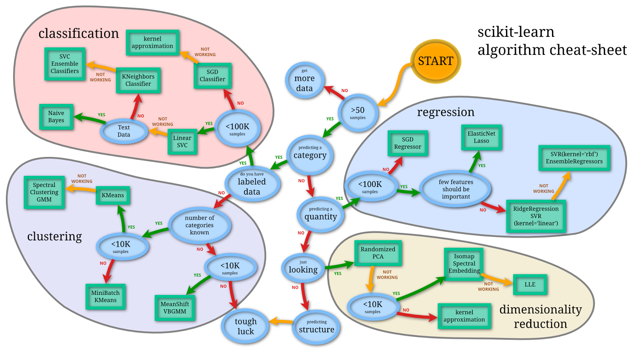
Selecting algorithms
http://www.quora.com/What-are-the-advantages-of-different-classification-algorithms

Slide 99
Using Weka
Weka (Waikato Environment for Knowledge Analysis) is a collection of open source, cross-platform, Java-based ML programs and tools for accessing them that let you fairly quickly and easily make use of a wide range of classification and other techniques
Originally produced by a team at the University of Waikato (New Zealand) and documented in a book:
Ian H. Witten and Eibe Frank (2005) "Data Mining: Practical machine learning tools and techniques", 2nd Edition, Morgan Kaufmann, San Francisco, 2005.

Slide 100
Download, Documentation, etc.
Home page
http://www.cs.waikato.ac.nz/ml/weka/
Download
http://www.cs.waikato.ac.nz/ml/weka/index_downloading.html
Documentation
Manual comes with the download
Requires Java VM (1.5 or later) (which you can get with the Weka download if you want)
Download and install Weka you will need it for Assignment #5

Slide 101
Data for Weka
Assumes data is a collection of (training) instance vectors
Features plus a label
Uses the term “attribute” to refer to an individual data value (either feature or label)

Slide 102
Data for Weka
Assumes data is a collection of (training) instance vectors
Features plus a label
Uses the term “attribute” to refer to an individual data value (either feature or label)
Primary data file format: ARFF (Attribute-Relation File Format)

Slide 103
Sample ARFF File
% Iris Plants Database (from R.A. Fischer and Michael Marshall)
%
@RELATION iris
@ATTRIBUTE sepallength NUMERIC
@ATTRIBUTE sepalwidth NUMERIC
@ATTRIBUTE petallength NUMERIC
@ATTRIBUTE petalwidth NUMERIC
@ATTRIBUTE class {Iris-setosa,Iris-versicolor,Iris-virginica}
@DATA
5.1,3.5,1.4,0.2,Iris-setosa
4.9,3.0,1.4,0.2,Iris-setosa
4.7,3.2,1.3,0.2,Iris-setosa
4.6,?,1.5,0.2,Iris-setosa
…

Slide 104
Sample ARFF File
% Iris Plants Database (from R.A. Fischer and Michael Marshall)
%
@RELATION iris
@ATTRIBUTE sepallength NUMERIC
@ATTRIBUTE sepalwidth NUMERIC
@ATTRIBUTE petallength NUMERIC
@ATTRIBUTE petalwidth NUMERIC
@ATTRIBUTE class {Iris-setosa,Iris-versicolor,Iris-virginica}
@DATA
5.1,3.5,1.4,0.2,Iris-setosa
4.9,3.0,1.4,0.2,Iris-setosa
4.7,3.2,1.3,0.2,Iris-setosa
4.6,?,1.5,0.2,Iris-setosa
…
A comment

Slide 105
Sample ARFF File
% Iris Plants Database (from R.A. Fischer and Michael Marshall)
%
@RELATION iris
@ATTRIBUTE sepallength NUMERIC
@ATTRIBUTE sepalwidth NUMERIC
@ATTRIBUTE petallength NUMERIC
@ATTRIBUTE petalwidth NUMERIC
@ATTRIBUTE class {Iris-setosa,Iris-versicolor,Iris-virginica}
@DATA
5.1,3.5,1.4,0.2,Iris-setosa
4.9,3.0,1.4,0.2,Iris-setosa
4.7,3.2,1.3,0.2,Iris-setosa
4.6,?,1.5,0.2,Iris-setosa
…
Name for this collection of data

Slide 106
Sample ARFF File
% Iris Plants Database (from R.A. Fischer and Michael Marshall)
%
@RELATION iris
@ATTRIBUTE sepallength NUMERIC
@ATTRIBUTE sepalwidth NUMERIC
@ATTRIBUTE petallength NUMERIC
@ATTRIBUTE petalwidth NUMERIC
@ATTRIBUTE class {Iris-setosa,Iris-versicolor,Iris-virginica}
@DATA
5.1,3.5,1.4,0.2,Iris-setosa
4.9,3.0,1.4,0.2,Iris-setosa
4.7,3.2,1.3,0.2,Iris-setosa
4.6,?,1.5,0.2,Iris-setosa
…
Name and type of each attribute

Slide 107
Sample ARFF File
% Iris Plants Database (from R.A. Fischer and Michael Marshall)
%
@RELATION iris
@ATTRIBUTE sepallength NUMERIC
@ATTRIBUTE sepalwidth NUMERIC
@ATTRIBUTE petallength NUMERIC
@ATTRIBUTE petalwidth NUMERIC
@ATTRIBUTE class {Iris-setosa,Iris-versicolor,Iris-virginica}
@DATA
5.1,3.5,1.4,0.2,Iris-setosa
4.9,3.0,1.4,0.2,Iris-setosa
4.7,3.2,1.3,0.2,Iris-setosa
4.6,?,1.5,0.2,Iris-setosa
…
Nothing special about this name But, Weka assumes the last attribute is the class unless you tell it otherwise (which you should!)

Slide 108
Data types
Numeric (can also declare to be Integer or Real)
String (Single quotes, backslash to escape a quote)
Date
Can specify exact parse/print format (see SimpleDataFormat)
Default: yyyy-MM-dd’T’HH:mm:ss
Nominal
Declared as list of values: {v1, v2, …, vn}
Case sensitive names in the actual data
Relational
Nested relation (list of attributes)
Given in actual data inside double quotes: “1,2,’foo’,Bar”

Slide 109
Sample ARFF File
% Iris Plants Database (from R.A. Fischer and Michael Marshall)
%
@RELATION iris
@ATTRIBUTE sepallength NUMERIC
@ATTRIBUTE sepalwidth NUMERIC
@ATTRIBUTE petallength NUMERIC
@ATTRIBUTE petalwidth NUMERIC
@ATTRIBUTE class {Iris-setosa,Iris-versicolor,Iris-virginica}
@DATA
5.1,3.5,1.4,0.2,Iris-setosa
4.9,3.0,1.4,0.2,Iris-setosa
4.7,3.2,1.3,0.2,Iris-setosa
4.6,?,1.5,0.2,Iris-setosa
…
Data is done as comma separated values

Slide 110
Sample ARFF File
% Iris Plants Database (from R.A. Fischer and Michael Marshall)
%
@RELATION iris
@ATTRIBUTE sepallength NUMERIC
@ATTRIBUTE sepalwidth NUMERIC
@ATTRIBUTE petallength NUMERIC
@ATTRIBUTE petalwidth NUMERIC
@ATTRIBUTE class {Iris-setosa,Iris-versicolor,Iris-virginica}
@DATA
5.1,3.5,1.4,0.2,Iris-setosa
4.9,3.0,1.4,0.2,Iris-setosa
4.7,3.2,1.3,0.2,Iris-setosa
4.6,?,1.5,0.2,Iris-setosa
…
Missing data denoted with a question mark

Slide 111
Data for Weka
Weka will also read simple comma-separated-value (CSV) files
Easy to create in Excel
First line is attribute names, rest are data
Weka will infer data types based on what it sees
And binary serialized data (from its own internal data structures)
Much faster to load
Note: Weka tends to want to use attribute numbers instead of names in specifications (but not output)
This tends to be messy: will want to remove attributes e.g., based on feature selection, but then the numbers change (Unfortunately, just one of many usability problems)

Slide 112
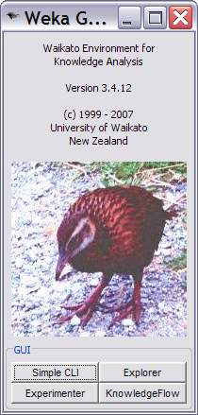
Running Weka
Will want to invoke using “with console” option
Exceptions (and other messages) will show up on the console
Occasionally the underlying Java crashes in ways that the Explorer UI does not catch (more bad UI…)
If it’s taking a lot longer than you expect, check the console…
Starts with this clever interface (press the “Explorer” button)

Slide 113
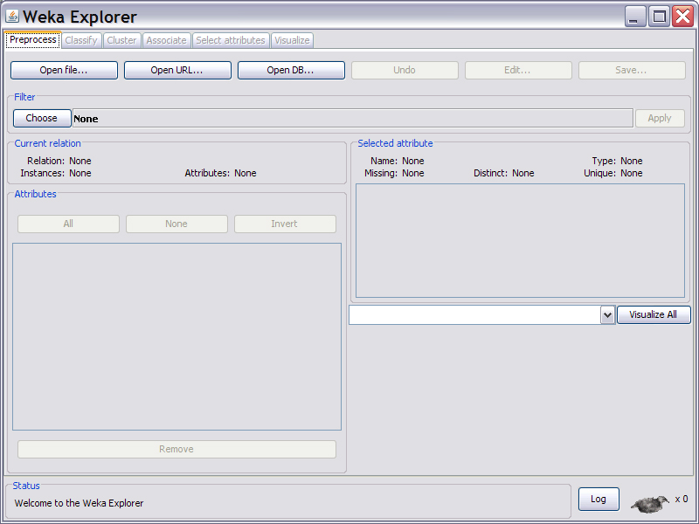
Explorer startup …press “Open file…”

Slide 114
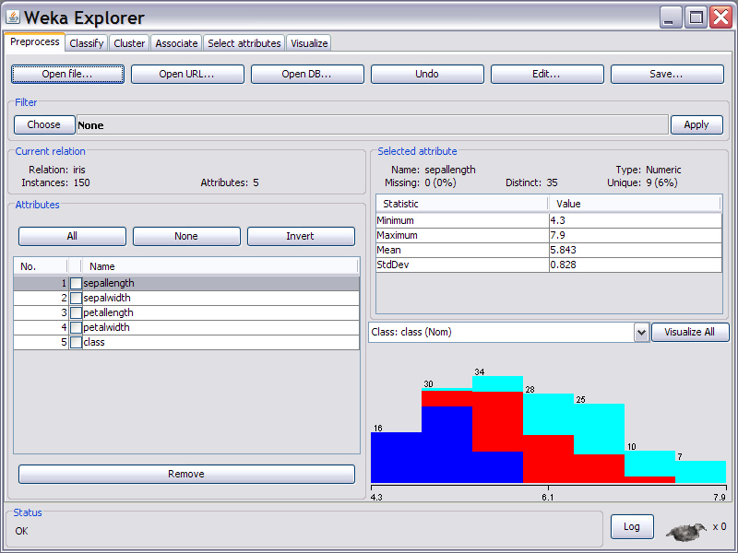

Slide 115
Can manually select features (attrs) here

Slide 116
Can apply programmatic selection here

Slide 117
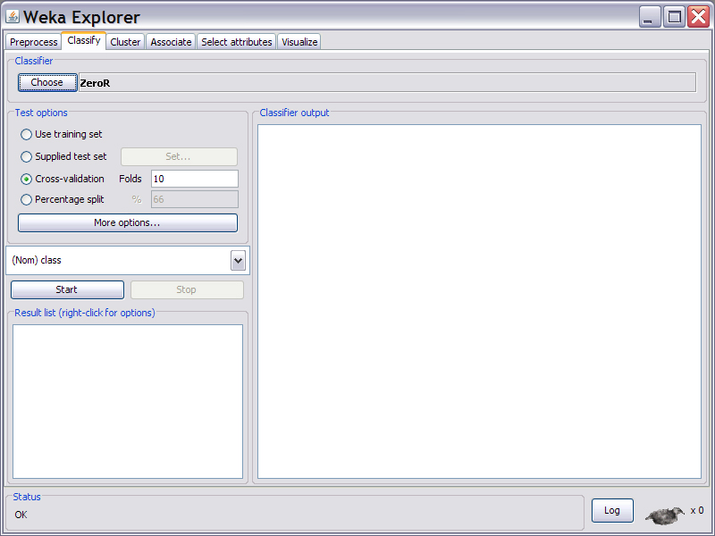
Let’s build a classifier (“Classify” tab)

Slide 118
Let’s build a classifier (“Classify” tab)
Set attribute that represents your class here
Must be done manually, before you try to learn
Common error to forget this!

Slide 119
Let’s build a classifier (“Classify” tab)
How testing is done (10-fold cross is default)

Slide 120
Let’s build a classifier (“Classify” tab)
Pick a type of classifier to learn with by pressing this button and selecting from long hierarchical list
We will choose J48 (C4.5 – like decision trees)

Slide 121
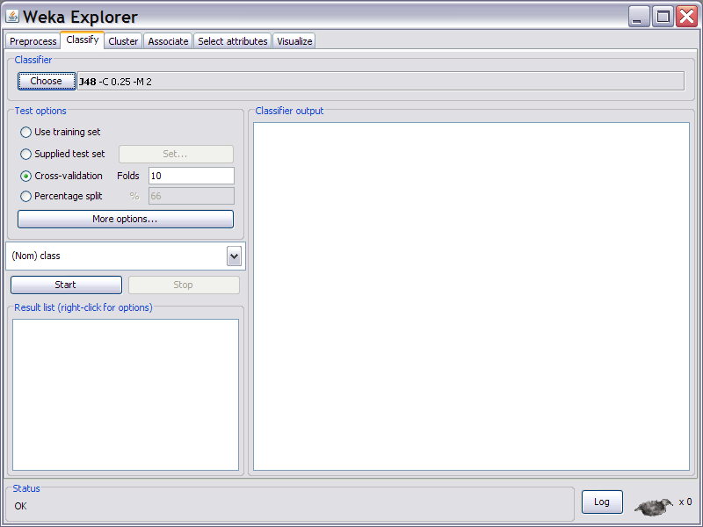
Name of classifier and command line arguments to specify it’s parameters appear here
Not obvious(!), but this text is clickable – click to change the parameters

Slide 122
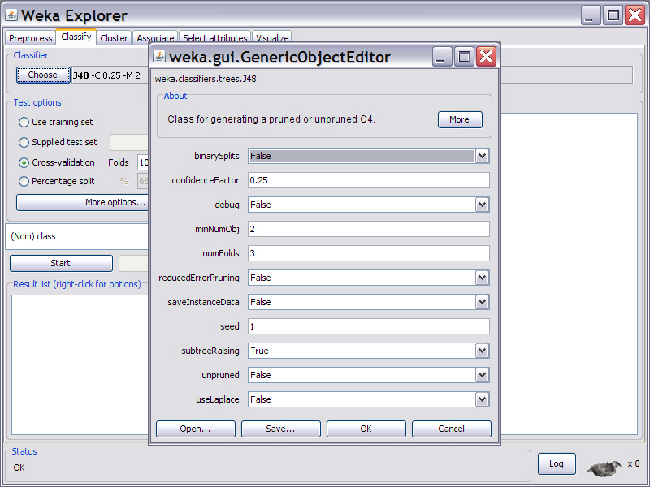
Parameter setting…

Slide 123
Parameter setting…
For data sets that aren’t tiny, change: this to ~ ≤0.1 and this to ~ ≥10
(but your mileage may vary…)

Slide 124
Press this button to build and test the classifier on the data you have loaded

Slide 125
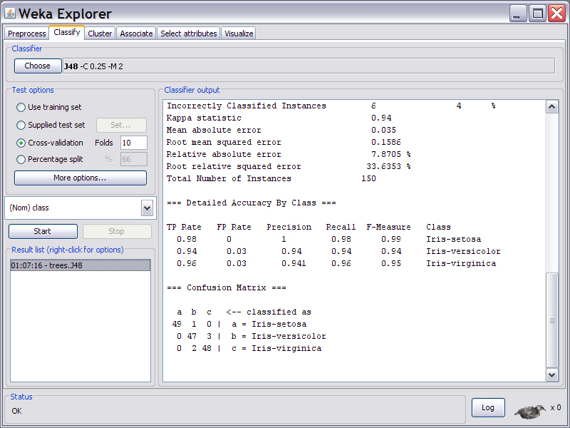
Results as textual output

Slide 126
Right-click here to save output, save resulting classifier, etc.

Slide 127
Output from this run…
=== Run information ===
Scheme: weka.classifiers.trees.J48 -C 0.25 -M 2
Relation: iris
Instances: 150
Attributes: 5
sepallength
sepalwidth
petallength
petalwidth
class
Test mode: 10-fold cross-validation

Slide 128
Output from this run…
=== Classifier model (full training set) ===
J48 pruned tree
------------------
petalwidth <= 0.6: Iris-setosa (50.0)
petalwidth > 0.6
| petalwidth <= 1.7
| | petallength <= 4.9: Iris-versicolor (48.0/1.0)
| | petallength > 4.9
| | | petalwidth <= 1.5: Iris-virginica (3.0)
| | | petalwidth > 1.5: Iris-versicolor (3.0/1.0)
| petalwidth > 1.7: Iris-virginica (46.0/1.0)
Number of Leaves : 5
Size of the tree : 9
Time taken to build model: 0.13 seconds

Slide 129
Output from this run…
=== Stratified cross-validation ===
=== Summary ===
Correctly Classified Instances 144 96 %
Incorrectly Classified Instances 6 4 %
Kappa statistic 0.94
Mean absolute error 0.035
Root mean squared error 0.1586
Relative absolute error 7.8705 %
Root relative squared error 33.6353 %
Total Number of Instances 150

Slide 130
Output from this run…
=== Detailed Accuracy By Class ===
TP Rate FP Rate Precision Recall F-Measure Class
0.98 0 1 0.98 0.99 Iris-setosa
0.94 0.03 0.94 0.94 0.94 Iris-versicolor
0.96 0.03 0.941 0.96 0.95 Iris-virginica
=== Confusion Matrix ===
a b c <-- classified as
49 1 0 | a = Iris-setosa
0 47 3 | b = Iris-versicolor
0 2 48 | c = Iris-virginica

Slide 131
From a naïve Bayes model… (Same accuracy, slightly diff confusion matrix)
Scheme: weka.classifiers.bayes.NaiveBayes
Relation: iris
…
Correctly Classified Instances 144 96 %
…
=== Confusion Matrix ===
a b c <-- classified as
50 0 0 | a = Iris-setosa
0 48 2 | b = Iris-versicolor
0 4 46 | c = Iris-virginica

Slide 132
Hint
Save results from all your runs
Hard to know what you may need (e.g. is trend in false positives going up or down as I change this parameter?)

Slide 133
Hint
Save results from all your runs
Put additional notes with the textual output!
Not everything you need to reconstruct what you did is in the textual output (can’t tell which feature subsets you learned on!)
You will run a lot of these trying various things and soon forget the details

Slide 134
Explorer allows you to try a bunch of things interactively (It can also do wrapper-based feature selection)
And anything you can do there can also be easily invoked from within a Java program for deployment
Java class of learner listed in output
Parameters for learner based on command line options which are also printed for you
weka.classifiers.trees.J48 -C 0.25 -M 2
Data tables for most classifier types can be saved in a file (from explorer) and pulled back in for classifier at runtime

Slide 135
Evaluation

Slide 136
How can I tell if my classifier is any good?
One measure: Training error
How many misclassifications of the training data
Typically not a good predictor for performance on new data
Holdout validation

Slide 137
Holdout Validation
Hold back some of your training data to test against
Train classifier on subset without holdout
Test (how many misclassifications) on holdout set
But need a large enough holdout set so you can trust the result (and this reduces your training data which you almost never have enough of)

Slide 138
How can I tell if my classifier is any good?
Better: K-fold Cross-validation
Break training data into K subsamples
K=10 very typical
For each subsample hold out that one and build a classifier with the remaining K-1 subsamples as training data
Test against holdout subsample; Average the results
Leave-one-out Cross-validation
K = size of the whole training data set

Slide 140
Train
Test

Slide 141
If Outlook = sunny, no
else if Outlook = overcast, yes
else if Outlook = rainy and Windy = TRUE, no
else yes
Performance on
training data?

Slide 142
If Outlook = sunny, no
else if Outlook = overcast, yes
else if Outlook = rainy and Windy = TRUE, no
else yes
Performance on
training data?
Performance on
testing data?

Slide 143
If Outlook = sunny, no
else if Outlook = overcast, yes
else if Outlook = rainy and Windy = TRUE, no
else yes
IMPORTANT!
If you evaluate the performance
of your rule on the same data
you trained on, you won’t
get an accurate estimate of
how well it will do on new data.

Slide 144
Simple Cross Validation
Fold: 1
TEST
1
Let’s say your data has attributes A, B, and C
You want to train a rule to predict D
First train on 2, 3, 4, 5, 6,7
and apply trained model to 1
The results is Accuracy1
TRAIN
2
TRAIN
3
TRAIN
4
TRAIN
5
TRAIN
6
TRAIN
7

Slide 145


Simple Cross Validation
Fold: 2
TRAIN
1
Let’s say your data has attributes A, B, and C
You want to train a rule to predict D
First train on 1, 3, 4, 5, 6,7
and apply trained model to 1
The results is Accuracy2
TEST
2
TRAIN
3
TRAIN
4
TRAIN
5
TRAIN
6
TRAIN
7

Slide 146
Simple Cross Validation
Fold: 3
TRAIN
1
Let’s say your data has attributes A, B, and C
You want to train a rule to predict D
First train on 1, 2, 4, 5, 6,7
and apply trained model to 1
The results is Accuracy3
TRAIN
2
TEST
3
TRAIN
4
TRAIN
5
TRAIN
6
TRAIN
7

Slide 147
Simple Cross Validation
Fold: 4
TRAIN
1
Let’s say your data has attributes A, B, and C
You want to train a rule to predict D
First train on 1, 2, 3, 5, 6,7
and apply trained model to 1
The results is Accuracy4
TRAIN
2
TRAIN
3
TEST
4
TRAIN
5
TRAIN
6
TRAIN
7
Notes:
And so on…

Slide 148
Simple Cross Validation
Fold: 4
TRAIN
1
Continue for all folds
Average the resulting accuracies
TRAIN
2
TRAIN
3
TEST
4
TRAIN
5
TRAIN
6
TRAIN
7
Notes:
And so on…

Slide 149
How can I tell if my classifier is any good?
How to select holdout subsample
Most commonly randomly selected partitions
“Stratified” → randomly choose partitions but in a way guaranteeing that each class is represented in approximately the right proportion
Stratified 10-fold cross-validation is most typical measure
But there are problems with this…
If the training data is not very independent
Multiple very similar (identical?) training instances
E.g., with temporal over sampling of sensors (i.e., values collected faster than sensors values typically change)
You will be back to testing against (a copy of part of) your training data
→ Estimates tend to end up too optimistic

Slide 150
How can I tell if my classifier is any good?
For HCI work you would often like to know: “If I give this classifier to a completely new user, how will it do?”
Argues for “per person” holdout (cross-validation)
Tends to give more realistic (less optimistic) estimates
But there can be issues with this which keep you from using it
Not enough different users and/or wildly variable amounts of data per users
Hard to compare results (5 users vs. 50 vs. can’t do it)
My recommendation: report both 10-fold random-holdout (stratified) cross-validation and per-person holdout cross-validation numbers (if you can reasonably do them)
10-fold random is quasi-standard and allows you to compare to all
Per-person is probably a better estimate

Slide 151
Remember!
If we are satisfied with the performance estimate we get using cross-validation
Then we build the model with the WHOLE SET
We don’t use cross-validation to build the model

Slide 152
Why do we do cross validation?
Use cross-validation when you do not have enough data to have completely independent train and test sets
We are trying to estimate what performance would you get if you trained over your whole set and applied that model to an independent set of the same size
We compute that estimate by averaging over folds

Slide 153
Do we have to do all of the folds?
Yes!
The test set on each fold is too small to give you an accurate estimate of performance alone
Variation across folds
Evaluation over part of the data is likely to be misleading

Slide 154
Why do we do cross validation?
Makes the most of your data – large portion used for training
Avoids testing on training data
Testing on training data will over estimate your performance!!!
But if you do multiple iterations of cross-validation, in some ways you are using insights from your testing data in building your model

Slide 155
Why do we do cross validation?
Do not have enough data to have completely independent train and test sets
Trying to estimate performance over your whole set
Makes the most of your data – large portion used for training

Slide 156
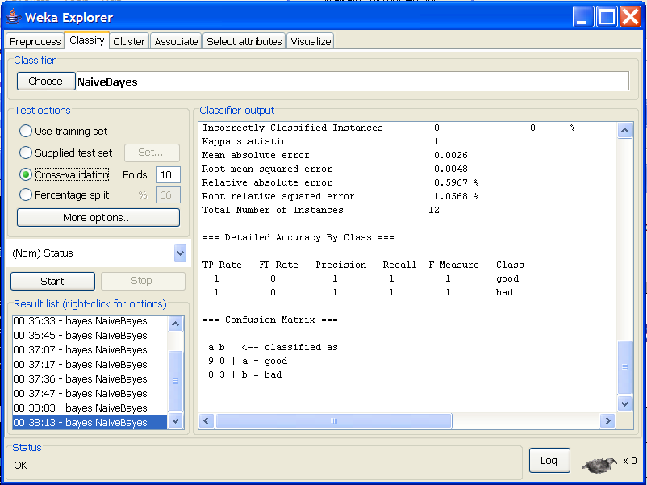
How To Do Cross Validation

Slide 157
How To Do Cross Validation
Notice that
Cross validation
is for testing
only! Not for
building the rule!

Slide 158
But then…..
If we are satisfied with the performance estimate we get
Then we build the model with the WHOLE SET
Now let’s see how it works…

Slide 159
But then…..
If you are not satisfied with the
performance you get,
then you should try to determine
what went wrong,
and then evaluate a different model
that compensates.
If we are satisfied with the performance estimate we get
Then we build the model with the WHOLE SET
Now let’s see how it works…

Slide 160
How can I tell if my classifier is any good?
How to select holdout subsample
Most commonly randomly selected partitions
“Stratified” → randomly choose partitions but in a way guaranteeing that each class is represented in approximately the right proportion
Stratified 10-fold cross-validation is most typical measure
But there are problems with this…
If the training data is not very independent
Multiple very similar (identical?) training instances
E.g., with temporal over sampling of sensors (i.e., values collected faster than sensors values typically change)
You will be back to testing against (a copy of part of) your training data
→ Estimates tend to end up too optimistic

Slide 161
How can I tell if my classifier is any good?
For HCI work you would often like to know: “If I give this classifier to a completely new user, how will it do?”
Argues for “per person” holdout (cross-validation)
Tends to give more realistic (less optimistic) estimates
But there can be issues with this which keep you from using it
Not enough different users and/or wildly variable amounts of data per users
Hard to compare results (5 users vs. 50 vs. can’t do it)
My recommendation: report both 10-fold random-holdout (stratified) cross-validation and per-person holdout cross-validation numbers (if you can reasonably do them)
10-fold random is quasi-standard and allows you to compare to all
Per-person is probably a better estimate

Slide 162
Feature Selection
Earlier indicated that feature selection is typically important to success
Very typical feature selection method: use information gain to “score” your features
Use the top N features ranked by information gain

Slide 163
Feature Selection
“Wrapper”-based feature selection
Combinatoric search / optimization through possible feature subsets using classifier accuracy as the objective function (this can be “wrapped” around any type of classifier)
Example (hill climbing):
Start with an empty set of selected features
Train a new classifier adding each candidate new feature
Keep the feature which produces the classifier with the best accuracy
Repeat until things stop improving
Can also start with all features and take away one at a time
More typical to do as simulated annealing rather than hill-climbing
This is an expensive process
Building and testing a classifier is “inside the loop” here so typically want a fast learner (e.g., naïve Bayes, decision trees)

Slide 164
What would happen if you do feature selection over your whole set of data prior to cross validation?

Slide 165
Overfitting!
Feature selection is part of model building
If you do feature selection over your whole set of data, including what you will test on, you have an unfair advantage
Your estimated performance will be overly optimistic!!
The same problem occurs if you design new features based on observations over your whole set of data.
Can you explain why?

Slide 166
Two Problems!!
At training time, if you include features that were designed based on the training data
Those features will perform better than they normally would
So your model will “trust them” too much
That will lead to poor model building
At testing time, if you have built a model using features you observed working well on your testing data
You have an unfair advantage
Normally those features wouldn’t show up with such a high predictive value
Double Whammy!!!

Slide 167
Correct Methodology
Set aside part of your data as a “development set” and create new features based on what you see in this set
Train on training data
Test on testing data (held out test set is most stringent)
Fine line: you should explore your data and get a sense of your data before model building – but don’t go so far as to induce features based on what you see

Slide 168
Software Tools
Weka (http://www.cs.waikato.ac.nz/ml/weka/)
Open source machine learning toolkit
Includes Java API
Data manipulation tools
Whatever you are comfortable with
Scripting language like Perl
Excel

Slide 169
If you want to know more…
Witten, I. H., Frank, E., Hall, M. (2011). Data Mining: Practical Machine Learning Tools and Techniques, third edition, Elsevier: San Francisco

Slide 170
Try it…

Slide 171
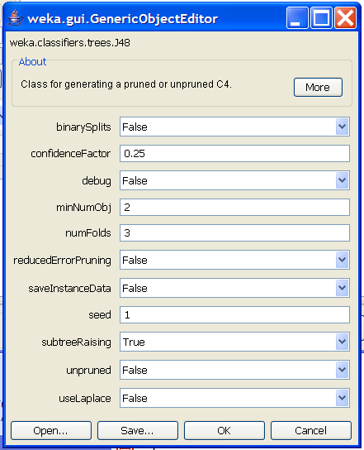
Tuning Decision Trees (J48)
Click on More button for documentation and references to papers
binarySplits: do you allow multi-way distinctions?
confidenceFactor: smaller values lead to more pruning
minNumObj: minimum number of instances per leaf
numFolds: Determines the amount of data for reduced error pruning – one fold used for pruning, the rest for growing the tree
reducedErrorPruning: whether to use reduced error pruning or not
subtreeRaising: whether to use subtree raising during pruning
Unpruned: whether pruning takes place at all
useLaplace: whether to use Laplace smoothing at leaf nodes

Slide 172
First Choice: Binary splits or not
Click on More button for documentation and references to papers
binarySplits: do you allow multi-way distinctions?
confidenceFactor: smaller values lead to more pruning
minNumObj: minimum number of instances per leaf
numFolds: Determines the amount of data for reduced error pruning – one fold used for pruning, the rest for growing the tree
reducedErrorPruning: whether to use reduced error pruning or not
subtreeRaising: whether to use subtree raising during pruning
Unpruned: whether pruning takes place at all
useLaplace: whether to use Laplace smoothing at leaf nodes

Slide 173
Second Choice: Pruning or not
Click on More button for documentation and references to papers
binarySplits: do you allow multi-way distinctions?
confidenceFactor: smaller values lead to more pruning
minNumObj: minimum number of instances per leaf
numFolds: Determines the amount of data for reduced error pruning – one fold used for pruning, the rest for growing the tree
reducedErrorPruning: whether to use reduced error pruning or not
subtreeRaising: whether to use subtree raising during pruning
Unpruned: whether pruning takes place at all
useLaplace: whether to use Laplace smoothing at leaf nodes

Slide 174
Third Choice: If you want to prune, what kind of pruning will you do?
Click on More button for documentation and references to papers
binarySplits: do you allow multi-way distinctions?
confidenceFactor: smaller values lead to more pruning
minNumObj: minimum number of instances per leaf
numFolds: Determines the amount of data for reduced error pruning – one fold used for pruning, the rest for growing the tree
reducedErrorPruning: whether to use reduced error pruning or not
subtreeRaising: whether to use subtree raising during pruning
Unpruned: whether pruning takes place at all
useLaplace: whether to use Laplace smoothing at leaf nodes

Slide 175
Fifth Choice: How to decide where to prune?
Click on More button for documentation and references to papers
binarySplits: do you allow multi-way distinctions?
confidenceFactor: smaller values lead to more pruning
minNumObj: minimum number of instances per leaf
numFolds: Determines the amount of data for reduced error pruning – one fold used for pruning, the rest for growing the tree
reducedErrorPruning: whether to use reduced error pruning or not
subtreeRaising: whether to use subtree raising during pruning
Unpruned: whether pruning takes place at all
useLaplace: whether to use Laplace smoothing at leaf nodes

Slide 176
Sixth Choice: Smoothing or not?
Click on More button for documentation and references to papers
binarySplits: do you allow multi-way distinctions?
confidenceFactor: smaller values lead to more pruning
minNumObj: minimum number of instances per leaf
numFolds: Determines the amount of data for reduced error pruning – one fold used for pruning, the rest for growing the tree
reducedErrorPruning: whether to use reduced error pruning or not
subtreeRaising: whether to use subtree raising during pruning
Unpruned: whether pruning takes place at all
useLaplace: whether to use Laplace smoothing at leaf nodes

Slide 177
Seventh Choice: Stopping Criterion
Click on More button for documentation and references to papers
binarySplits: do you allow multi-way distinctions?
confidenceFactor: smaller values lead to more pruning
minNumObj: minimum number of instances per leaf
numFolds: Determines the amount of data for reduced error pruning – one fold used for pruning, the rest for growing the tree
reducedErrorPruning: whether to use reduced error pruning or not
subtreeRaising: whether to use subtree raising during pruning
Unpruned: whether pruning takes place at all
useLaplace: whether to use Laplace smoothing at leaf nodes
This should be increased
for noisy data sets!

